Slide 1
HTTP and Abstraction on the Internet / The Need for DNS
Unit 1- Lesson 12 & 13

Slide 2
DNS
Domain Name System
Internet’s system for converting alphabetic names into numeric IP addresses
Internet Simulator

Slide 3
Video
The Internet: IP Addresses and DNS (code.org)

Slide 4
DNS Activities
Activity- DNS Partner Questionnaire
Worksheet- Names and Addresses

Slide 5
Vocabulary
HTTP HyperText Transfer Protocol
Abstraction (Definition)- the quality of dealing with ideas rather than events
Abstraction: Reducing information and detail to focus on essential characteristics. It is typically possible to look at a system at many levels of abstraction, depending on how much detail is necessary to approach the challenge at hand.
Server: A computer that awaits and responds to requests for data
Example: a DNS server awaits and responds to requests for URLs to be translated to IP addresses.
Client: A computer that requests data stored on a server
Example: When you type an address into your browser, your computer is the client and it sends the request to the DNS server.

Slide 6
HTTP- Hypertext Transfer Protocol
HTTP like DNS is an ASCII-text based protocol
It’s just two computers sending text messages to each other
What makes it a protocol are the rules of the “conversation” the two machines are having
Call-and-response protocol for a client/server relationship, where a client requests a web page or other content (image, sound, video, etc.) from a server

Slide 7
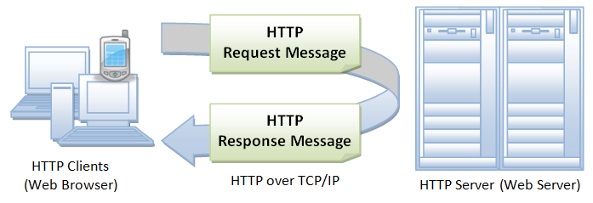
HTTP- Hypertext Transfer Protocol
HTTP as a “high level” protocol that sits on top of all the other protocols and internet systems we’ve learned about in the course
HTTP message conversation between the computers is being broken up into TCP/IP packets, and all the data gets sent as bits over wires and airwaves, taking different paths, and it gets interpreted reassembled at the end.

Slide 8
HTTP- Hypertext Transfer Protocol
Internet works in “layers” and this is a perfect example of abstraction on the Internet, as one layer makes use of the functionality provided by the layer below it, without worrying about the details of how this functionality is achieved
HTTP doesn’t have to worry about anything other than the text protocol of HTTP works
The network software and devices on your and others’ computers handle looking up addresses, breaking down data, packeting, routing, transmission and interpretation and reassembly. It’s really amazing

Slide 9
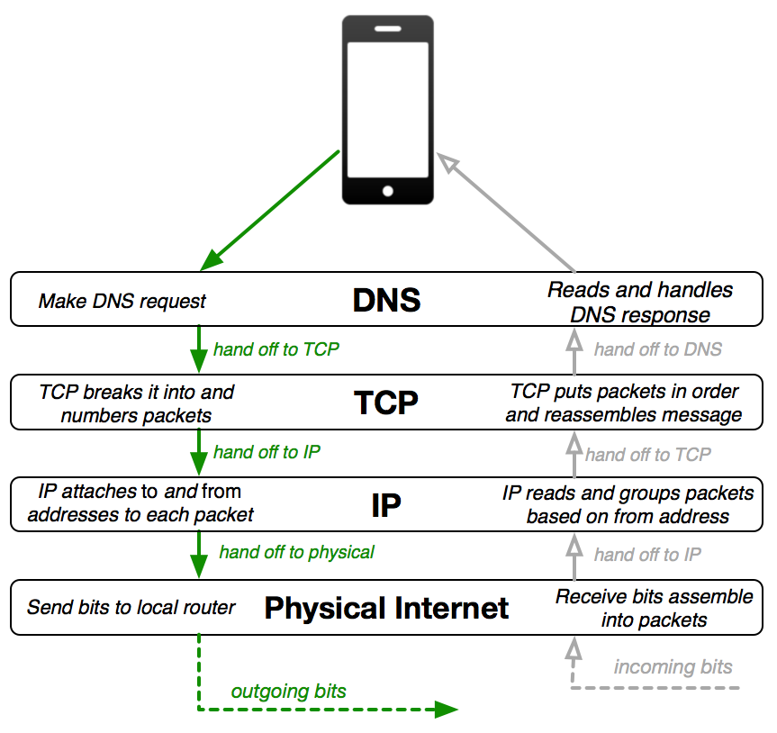
Handout-
HTTP and Abstraction on the Internet

Slide 10
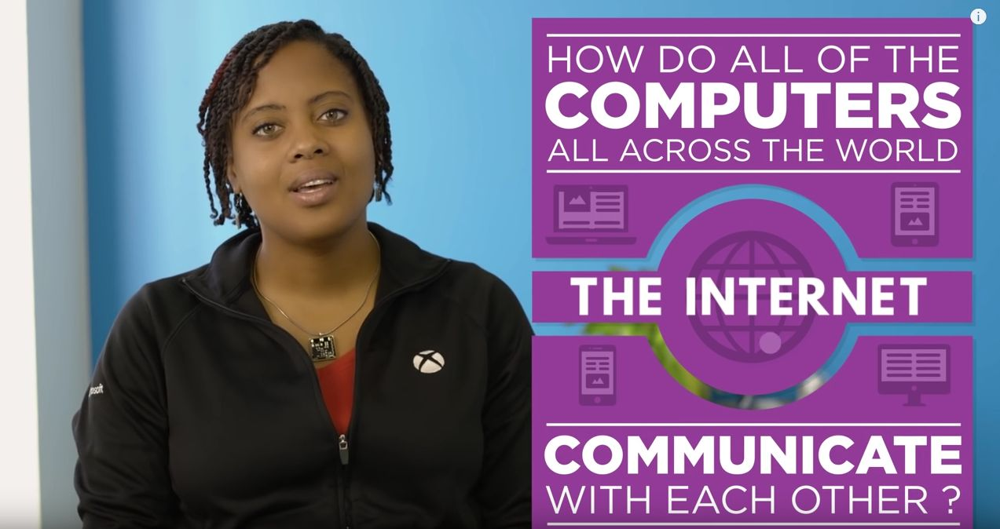
Video- The Internet: HTTP and HTML

Slide 11
Activity and Worksheets
HTTP in Action (Individual Assignment)
Access the developer tools of your browser
Monitor the HTTP traffic generated by visiting a variety of websites

Slide 12
Review Lesson 12
Why does the Internet use IP addresses?
Why don’t we need to know IP addresses?
Why do we need a Domain Name System?
Why don’t we all maintain our own DNS?
Is there one big DNS for the entire Internet?
How do you think all these DNS servers are maintained?

Slide 13
Static vs Dynamic Web Pages
A static web page (sometimes called a flat page/stationary page) is a web page that is delivered to the user exactly as stored, in contrast to dynamic web pages which are generated by a web application
Advantages of static website:
Quick to develop
Cheap to develop
Cheap to host
Disadvantages of static website:
Requires web development expertise to update site
Content can get stagnant

